Slide 1
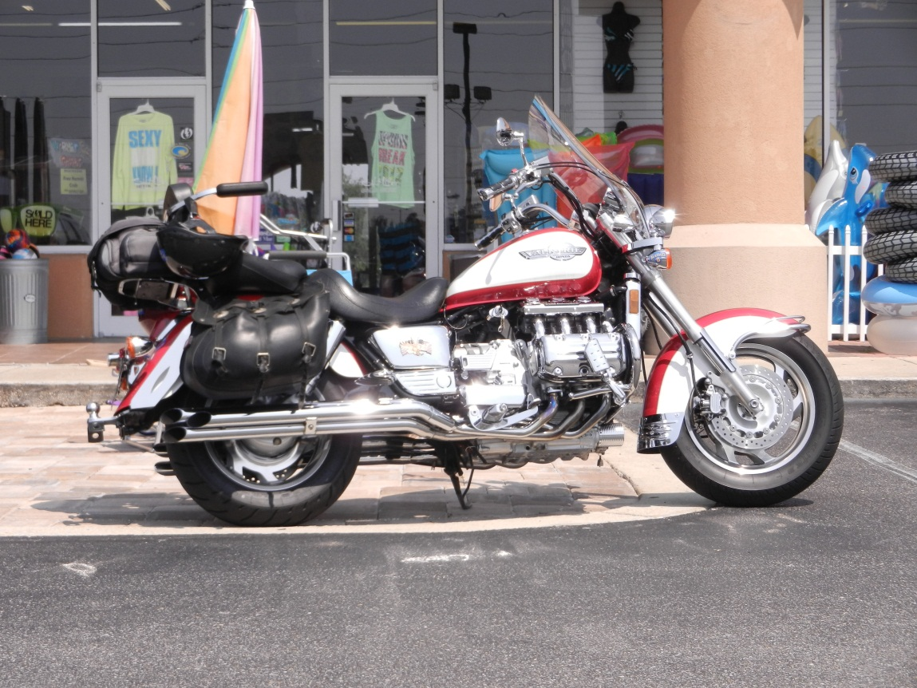
Rear End Service
Honda Valkyrie
Plus Changing Drive Dampeners

Slide 2
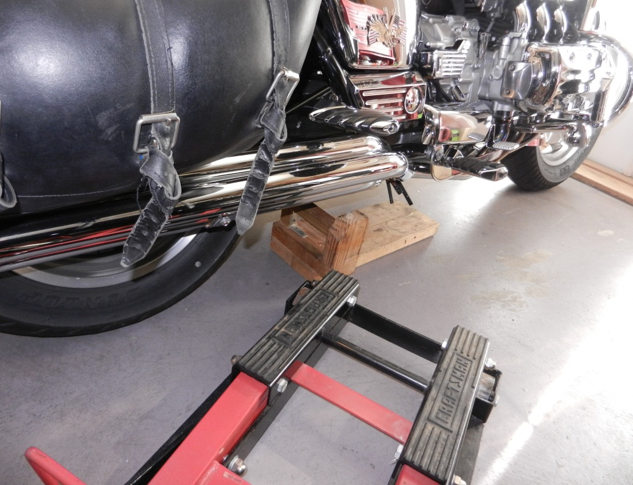
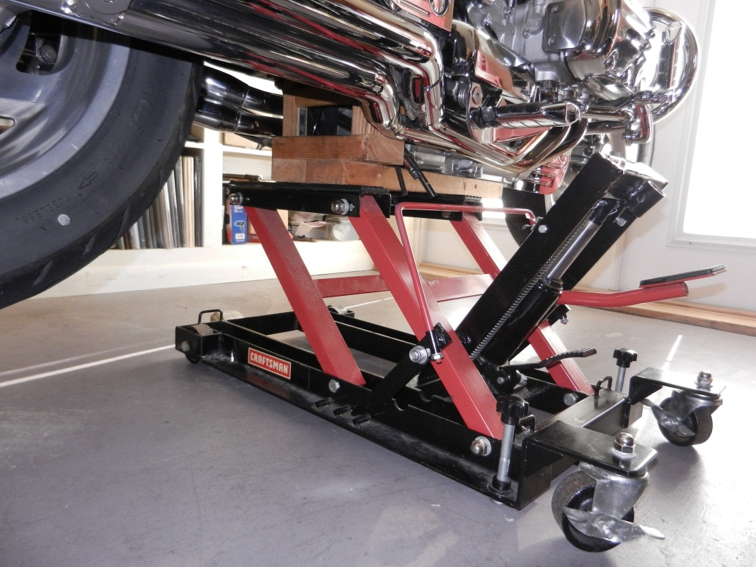
Lift with Wood Adapter
Engage safety

Slide 3
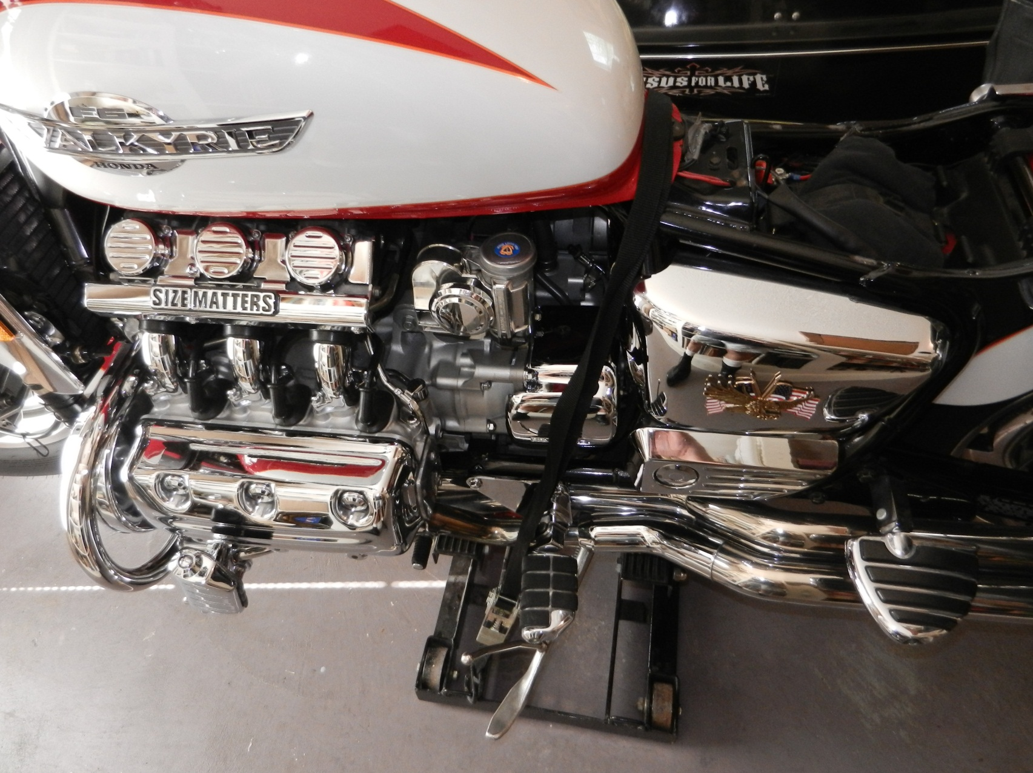
Remove seat, Tie Down

Slide 4
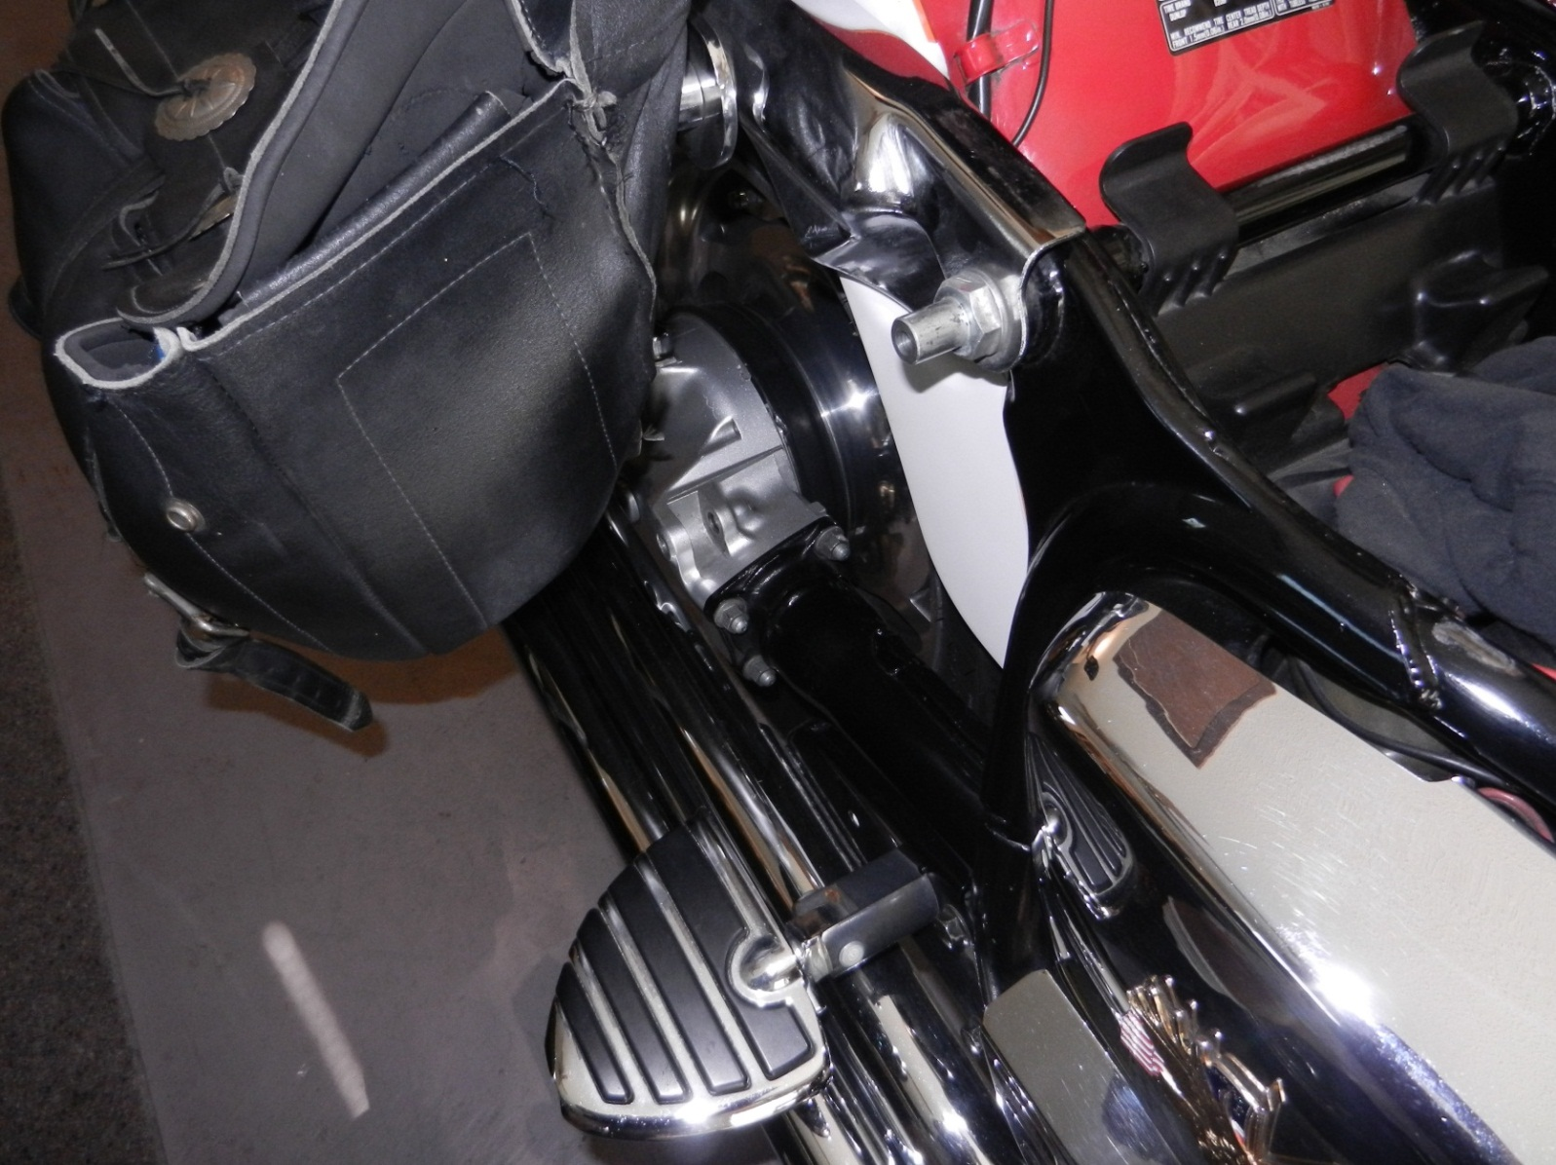
Remove Right Side Shock
The four bolt to remove the final drive are easy to access with the shock removed
4 bolts to remove final drive

Slide 5
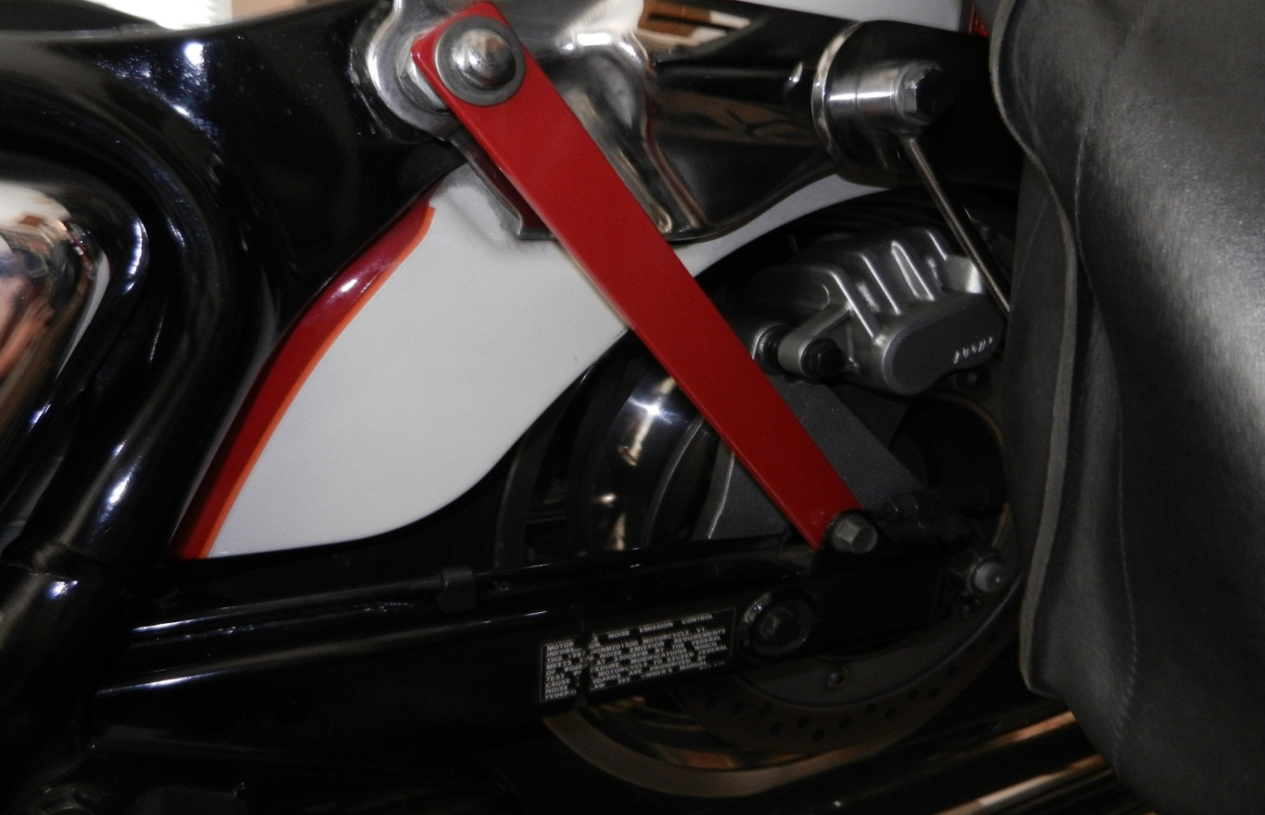
Remove left side shock/Replace with solid short bar (substitute a tie down strap…lower shock mount to sissy bar)
Now the axle is above the exhausts so you don’t have to mess with exhaust at all
Caliper plate holding pin

Slide 6
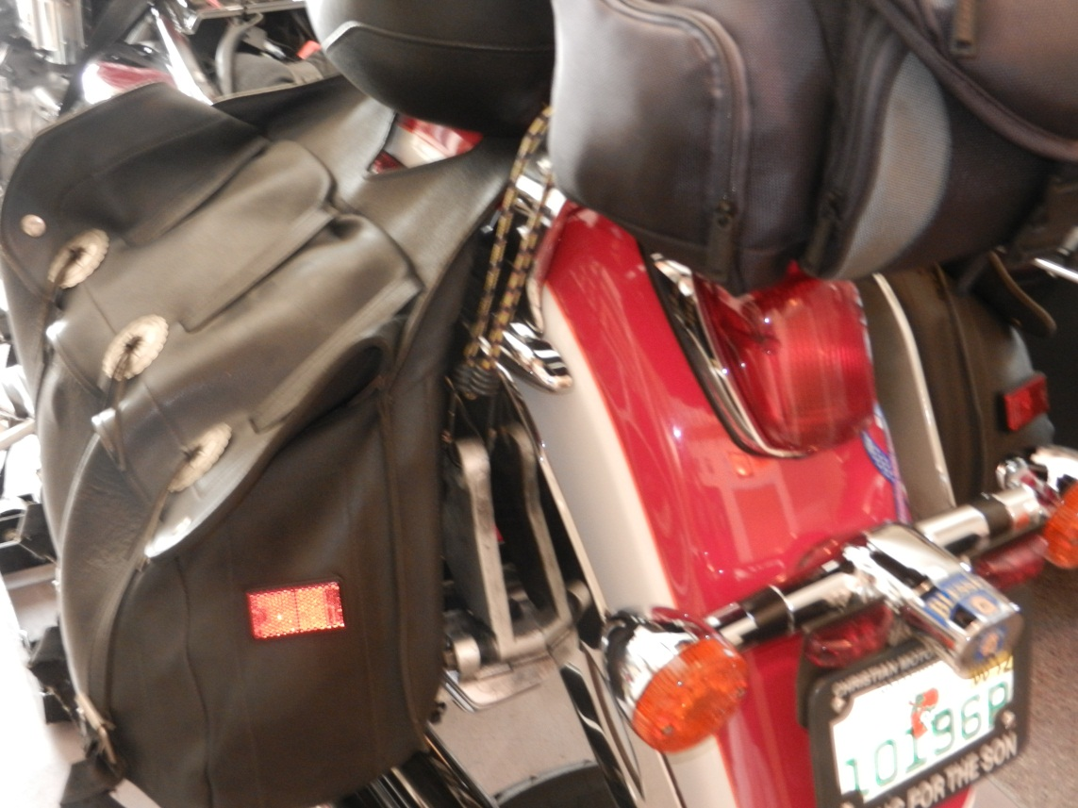
Remove the Caliper holding pin, axle nut & axle, then slide the caliper off the rotor and tie it up
I use a bungee cord to keep tension off the hydraulic line and the caliper out of the way

Slide 7
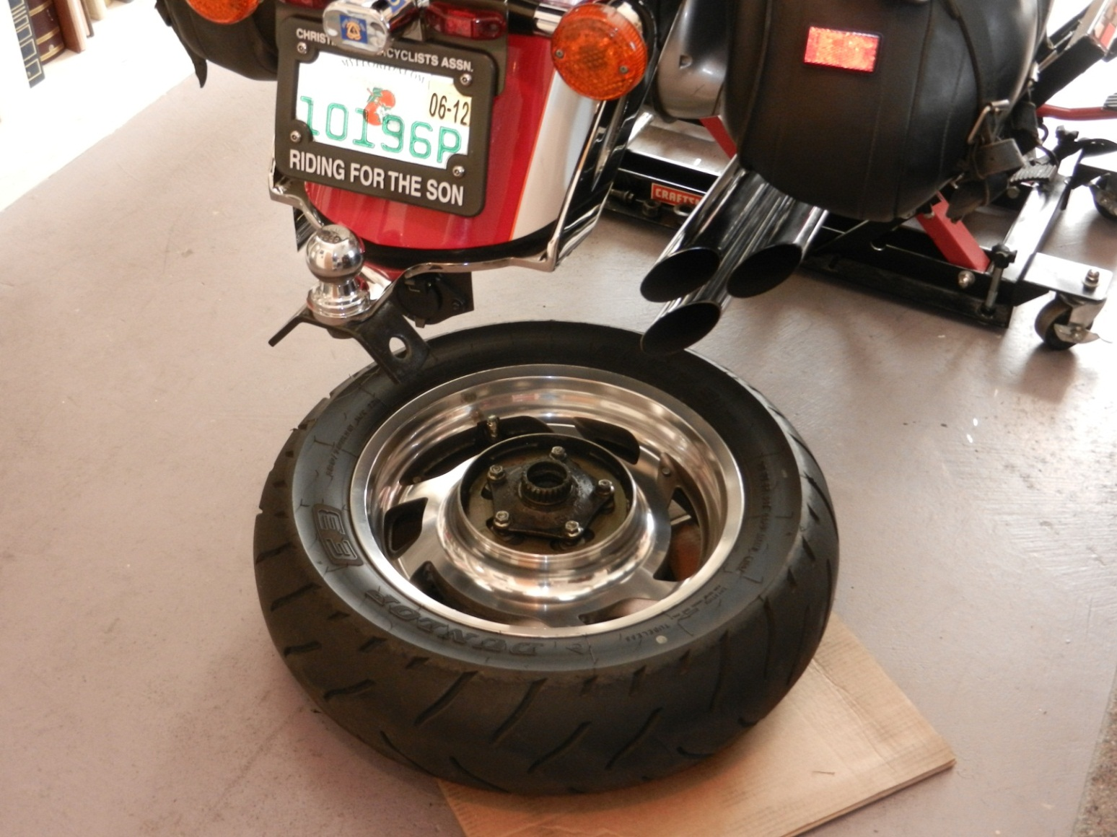
Remove the wheel

Slide 8
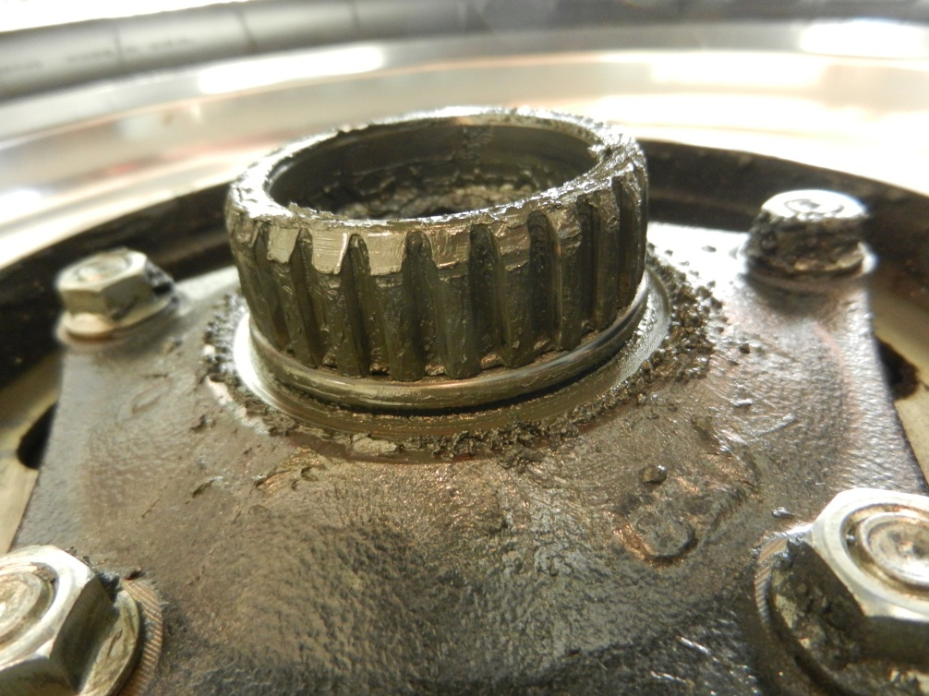
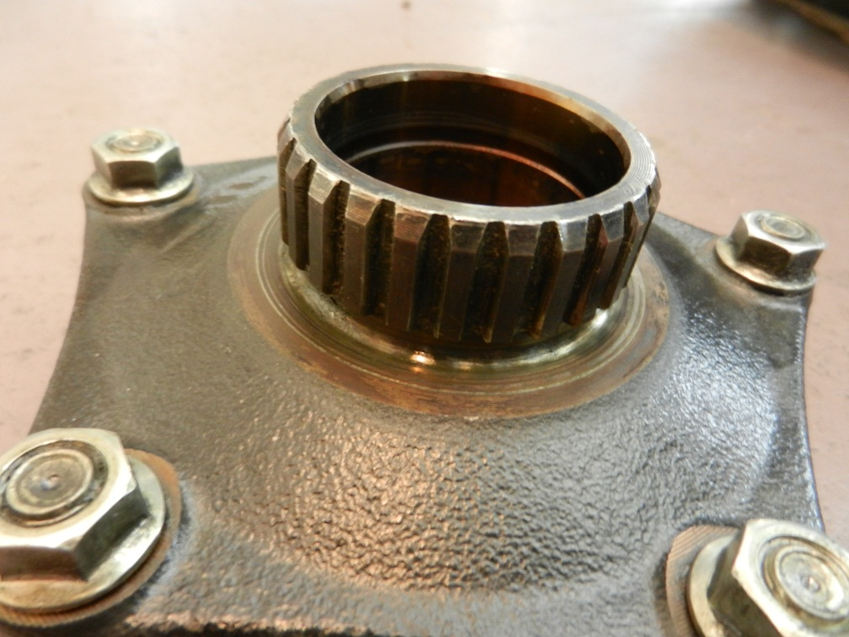
Splines are great
Now remove the four final drive bolts and remove the drive train

Slide 9
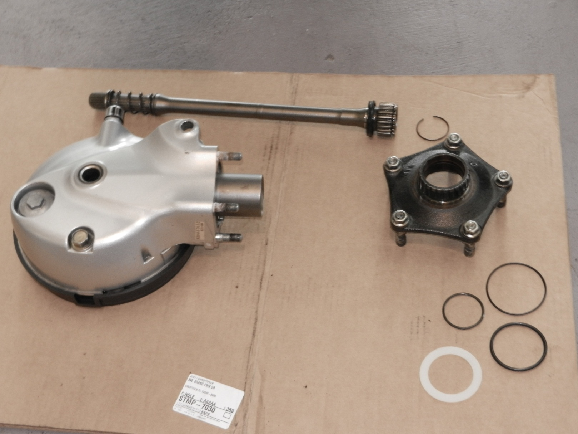
Parts all cleaned up
New 0-rings and Thrust washer

Slide 10
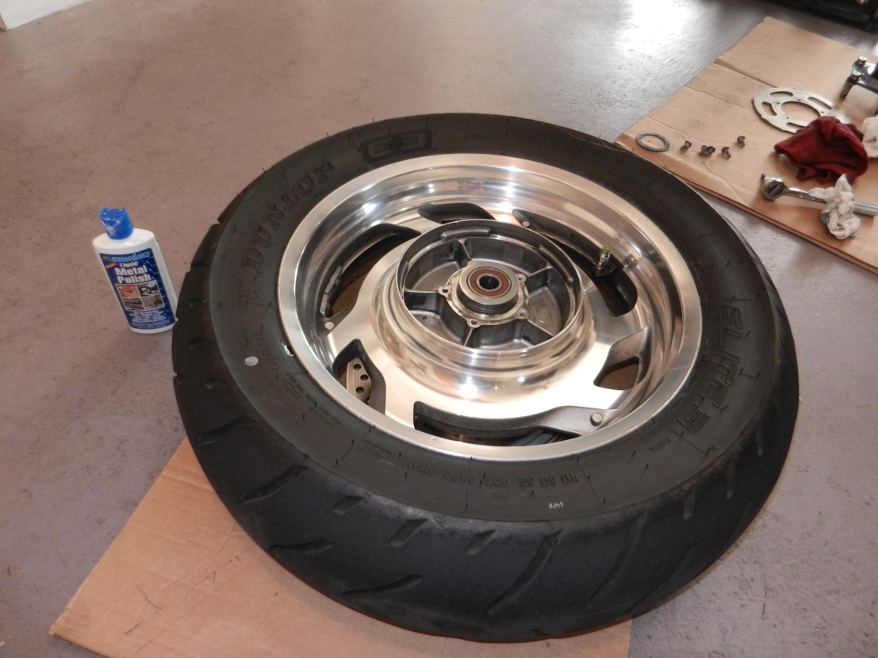
Remove Flange, Dampener Plate and Dampeners

Slide 11
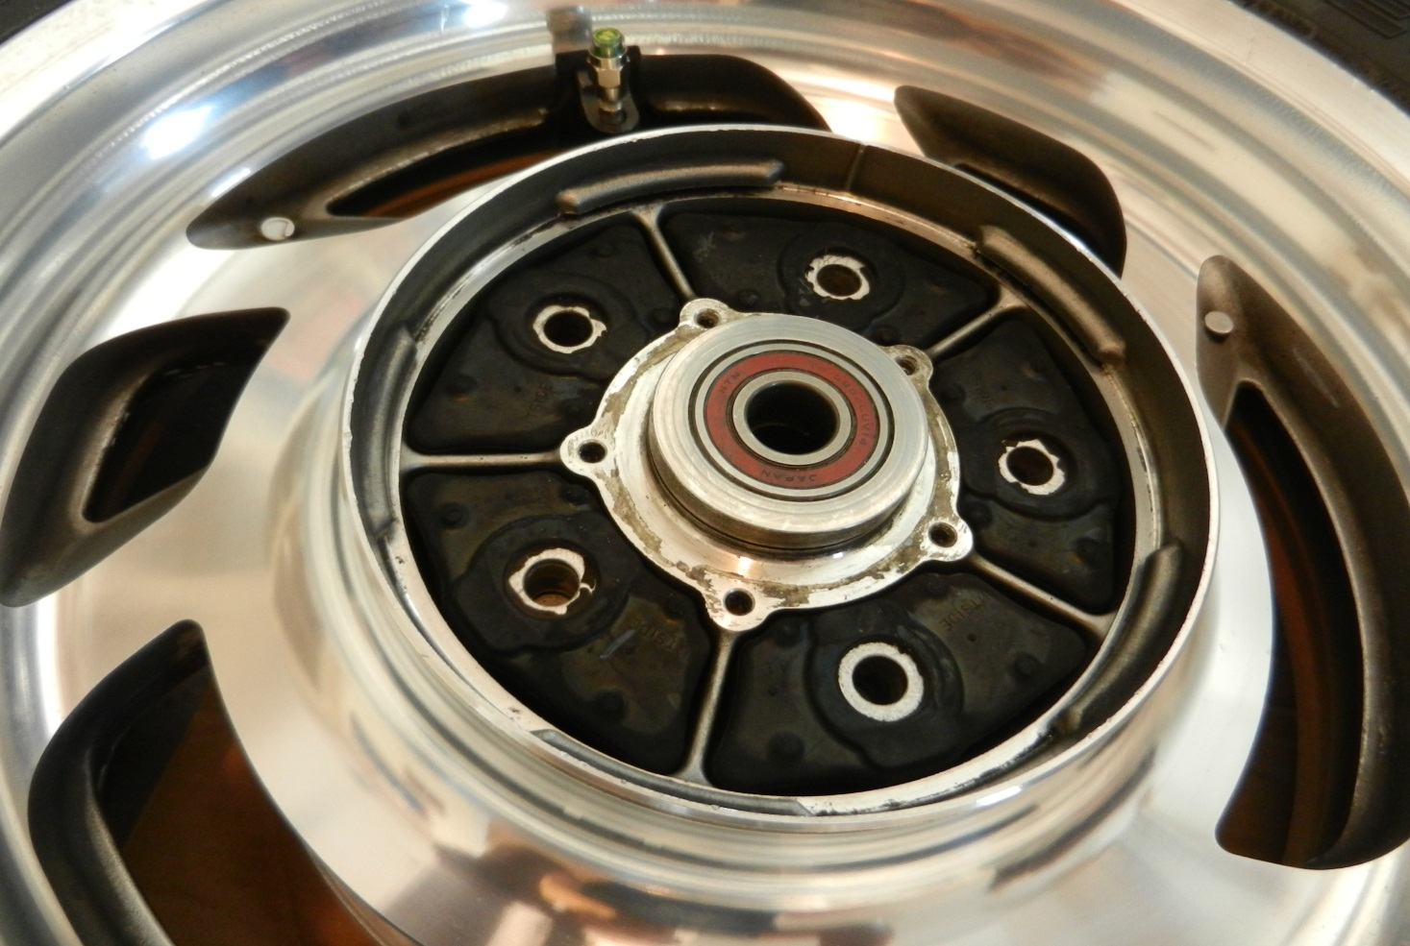
Install new Dampeners “outside” Out
They fit much better after sleeping in the freezer all night

Slide 12
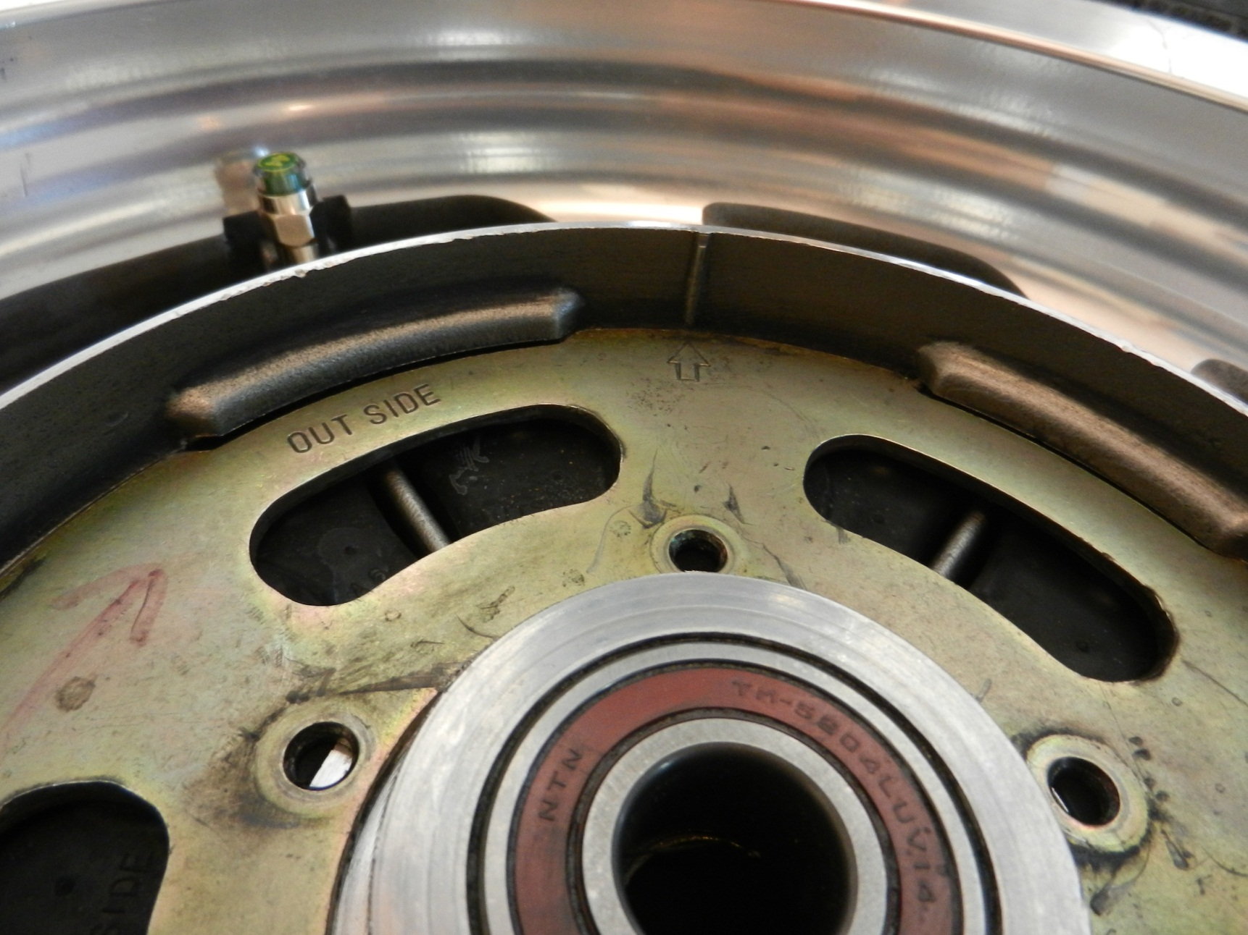
Line up the arrow and line

Slide 13
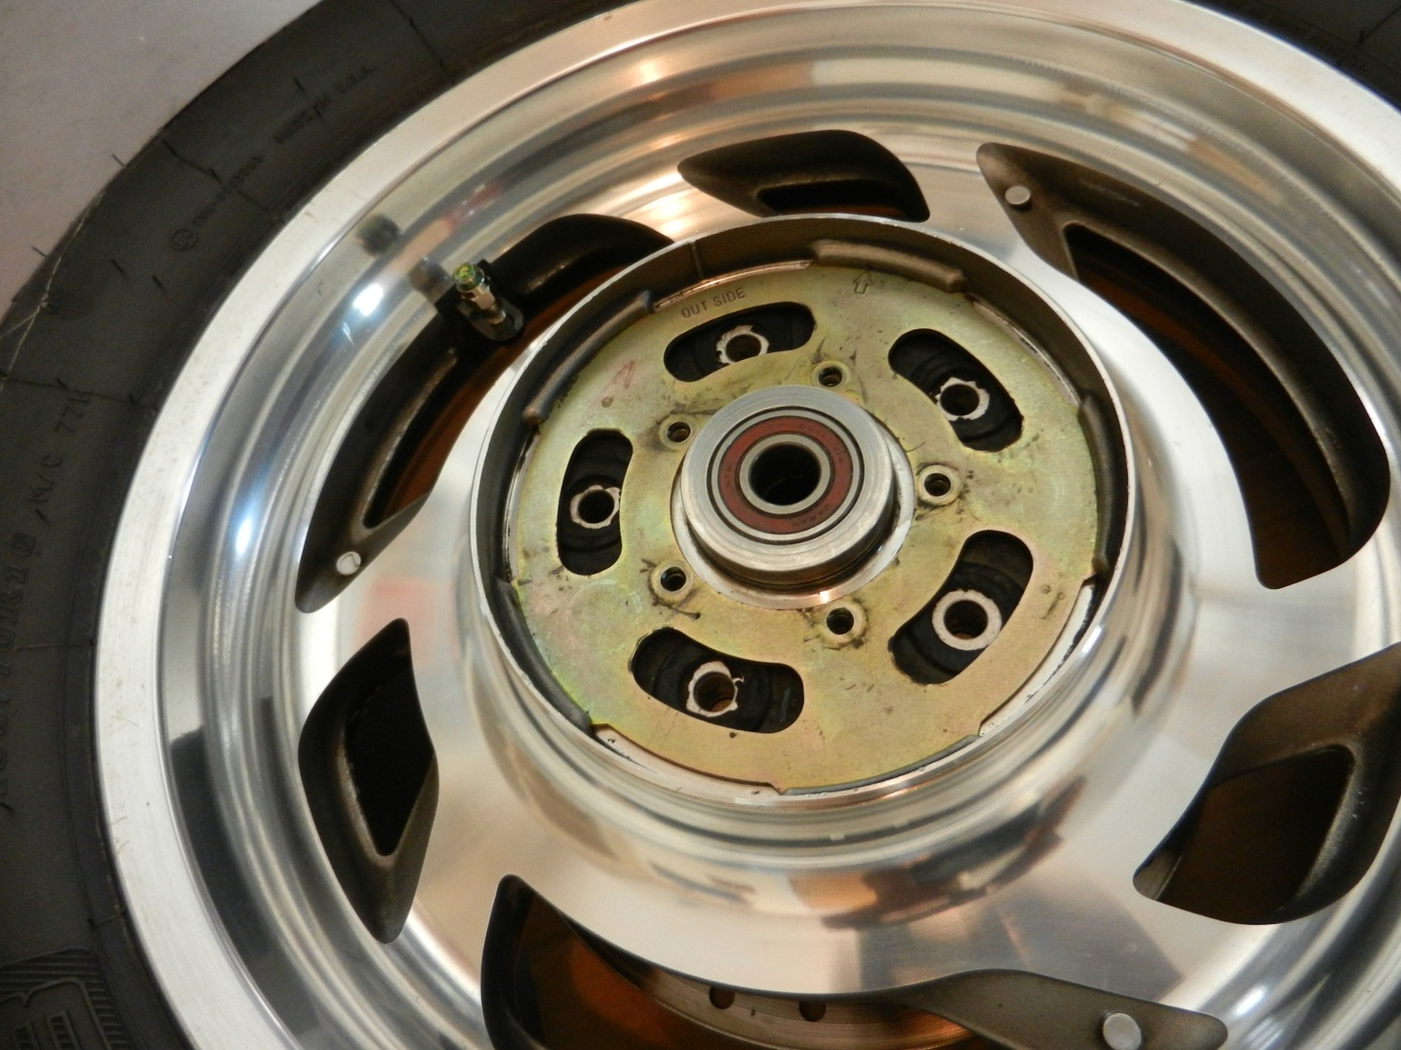
Turn the plate so the tabs go in the grooves locking the dampners in

Slide 14
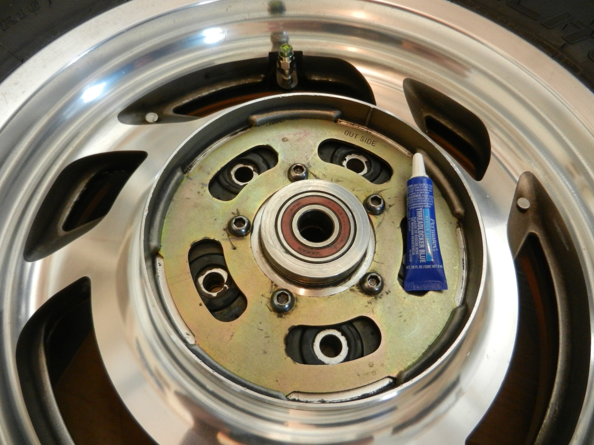
Blue locktite and bolt the plate in

Slide 15
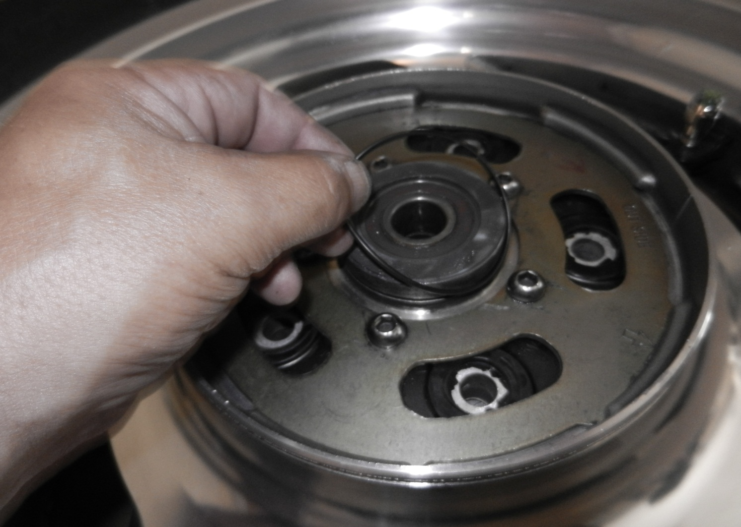
Light grease on the Thrust washer and put on the new O-Ring
Thrust Washer sitting on top of the hub

Slide 16
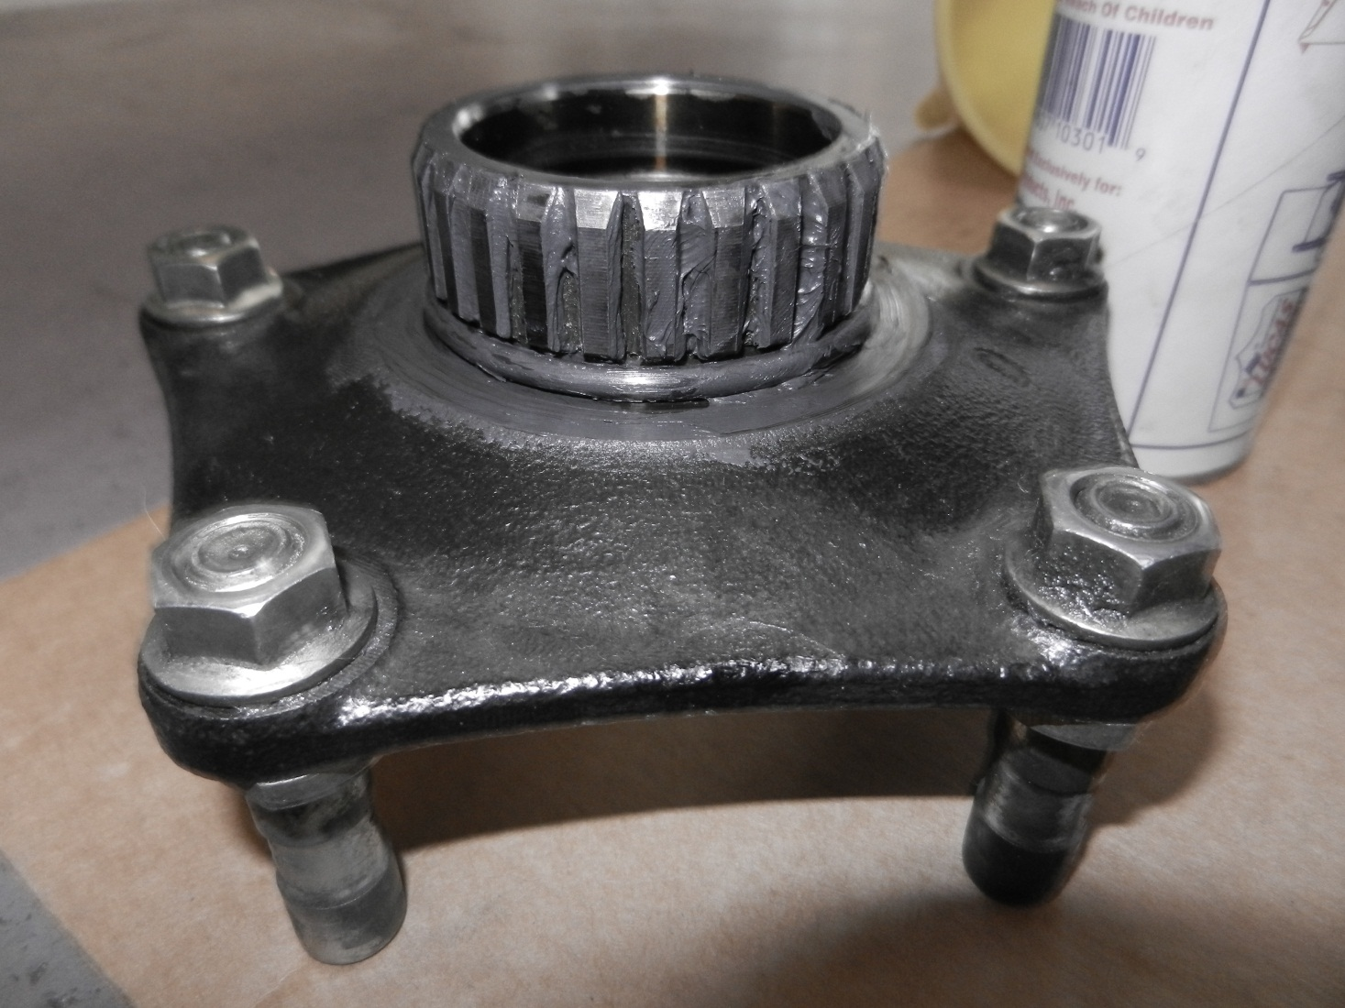
Light Grease on the Flange/New Big O-Ring

Slide 17
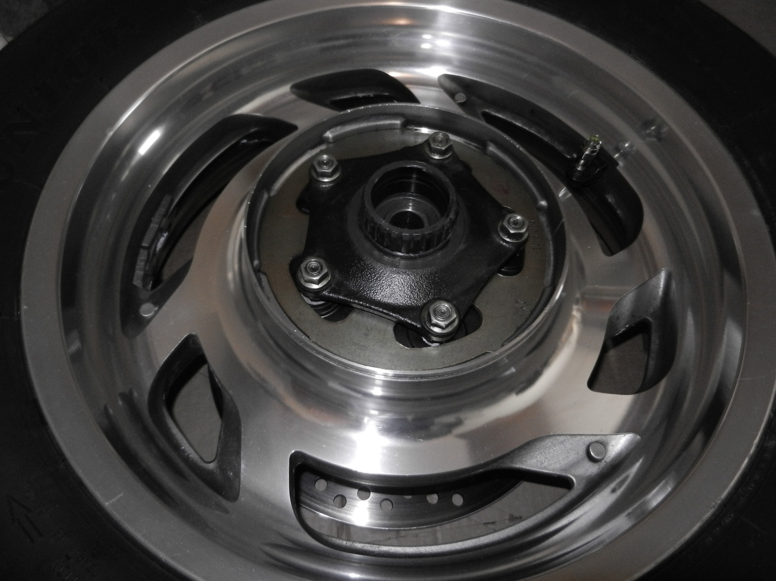
Wheel all ready for Installation

Slide 18
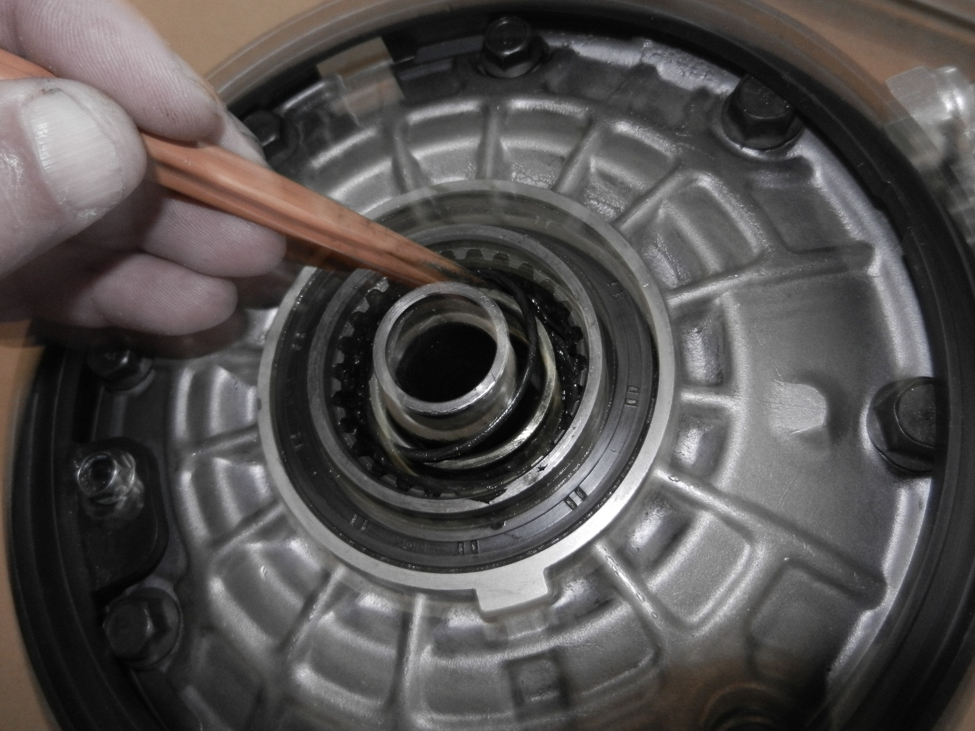
The Elusive Third O-Ring

Slide 19
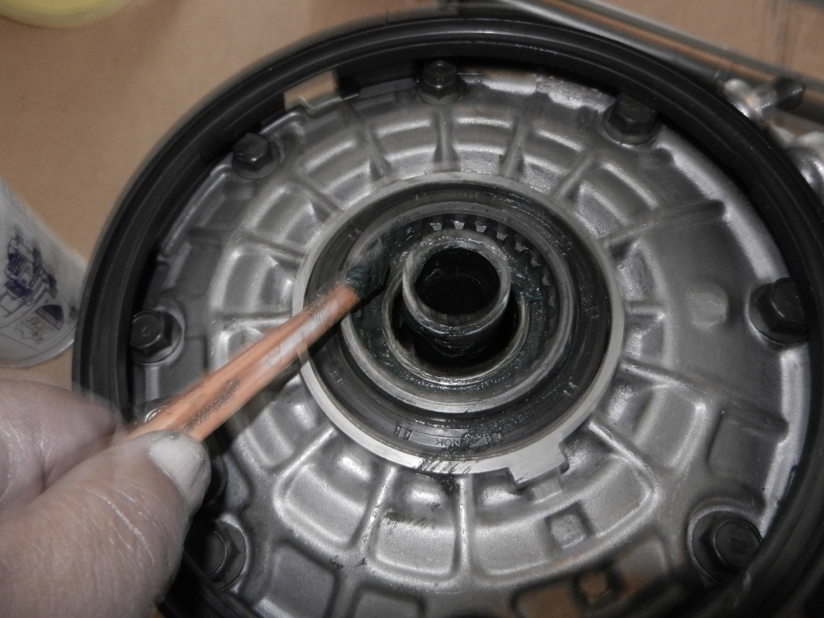
After cleaning the old grease out…put new grease in the female side of the splines. Light coat of Moly (Guard Dog) and then Lucas Grease

Slide 20
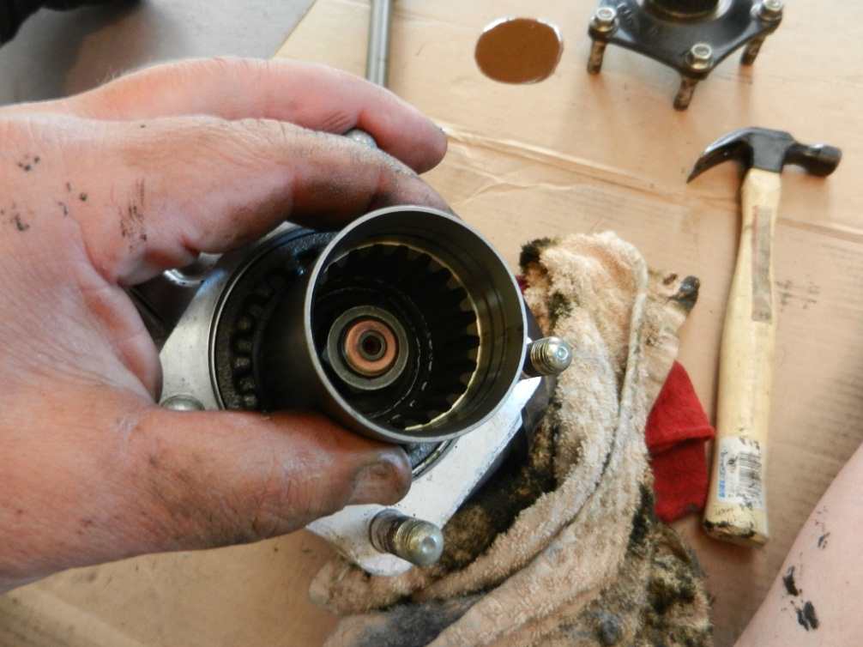
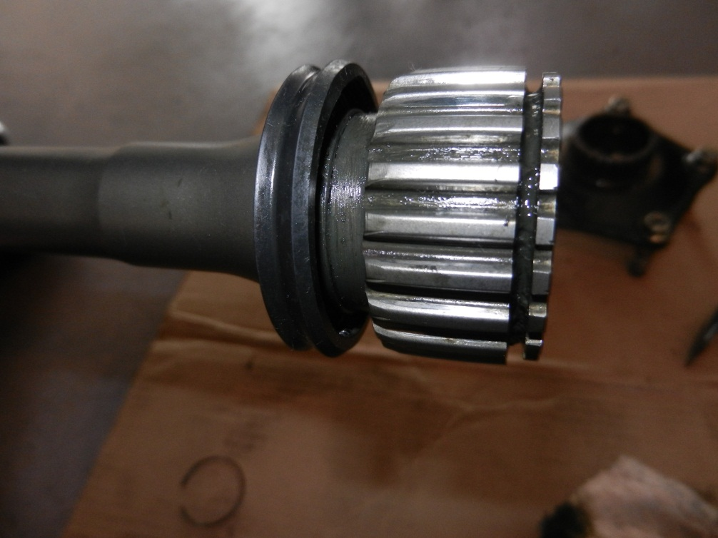
Pinion Cup and Drive Shaft are good

Slide 21
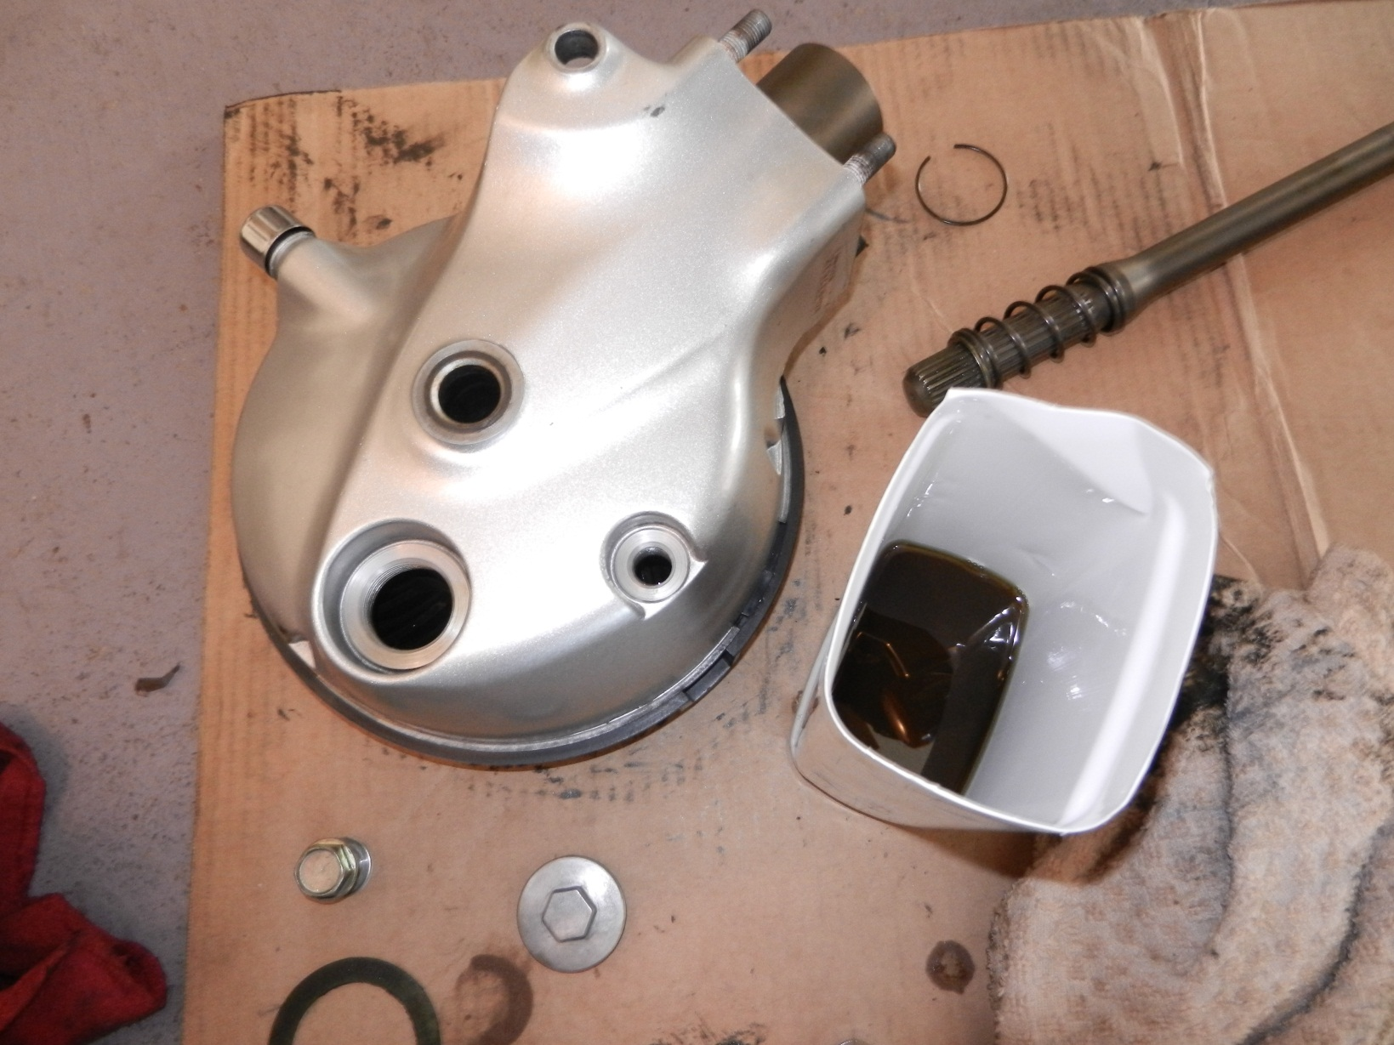
Drain the Final Drive

Slide 22
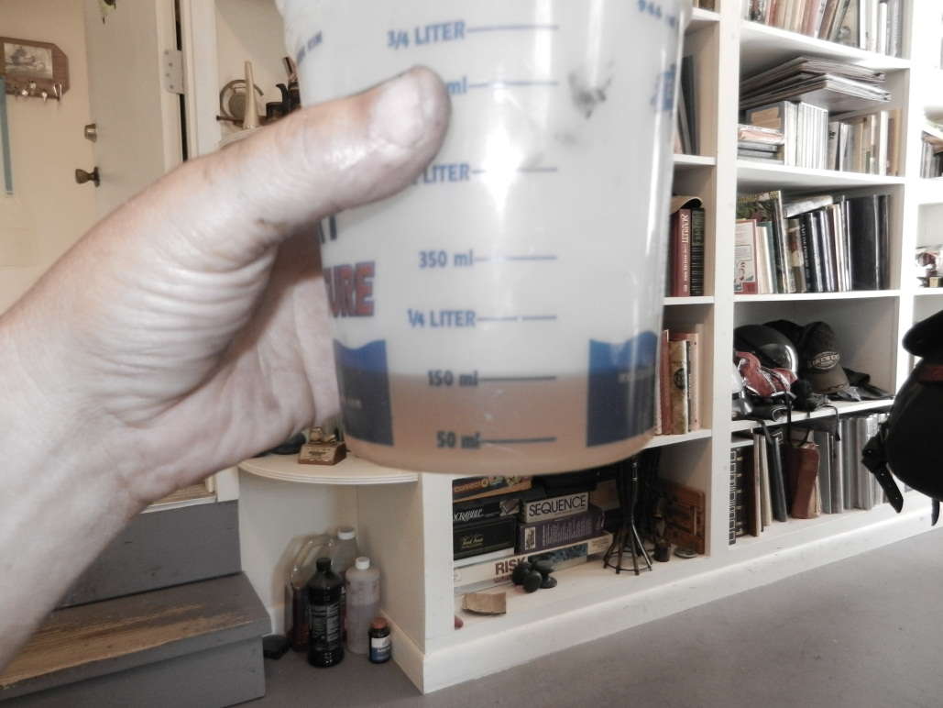
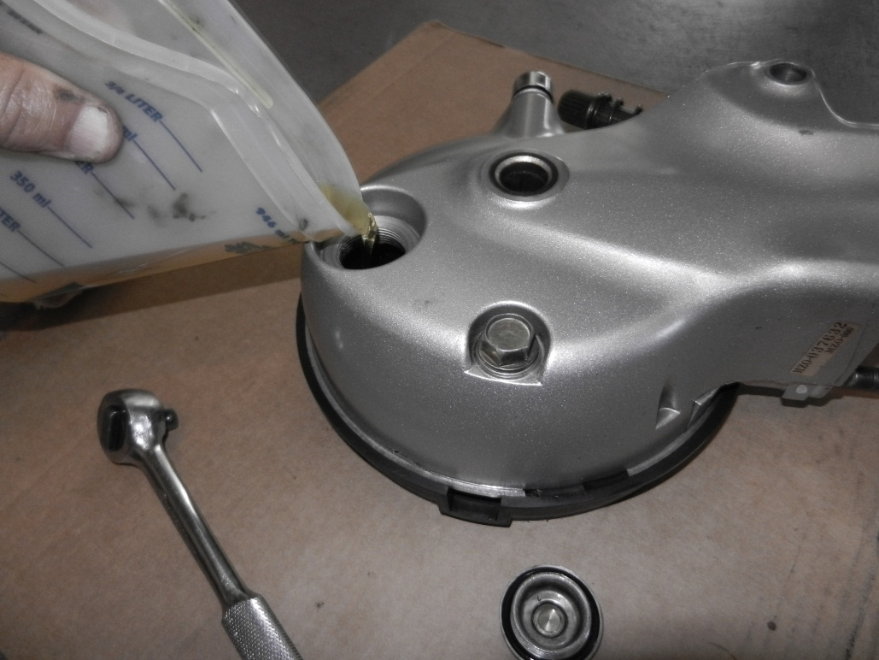
Fill with Hypoid Gear Oil (150cc)

Slide 23
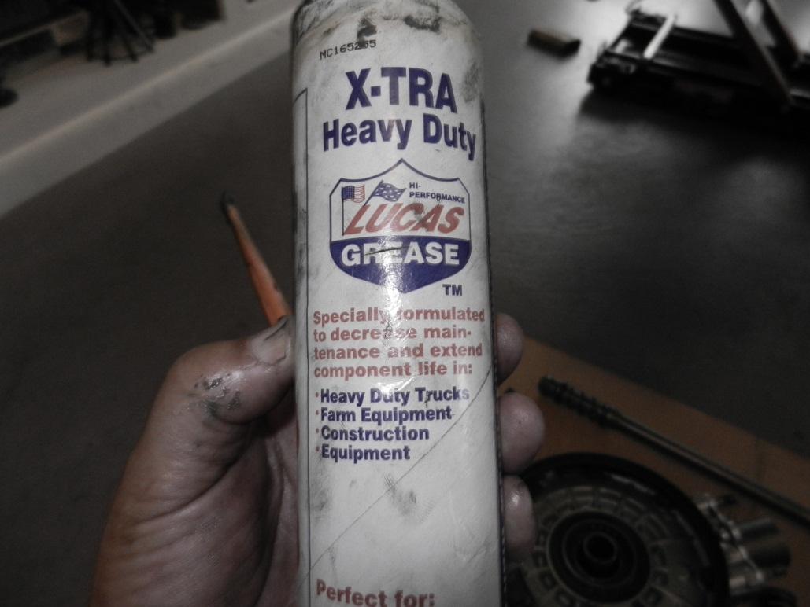
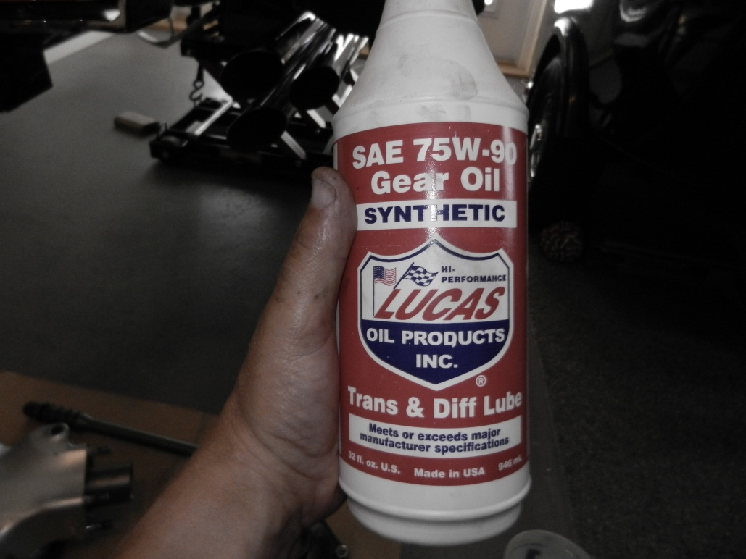
Grease is Lucas Heavy Duty/ Oil is Lucas Synthetic

Slide 24
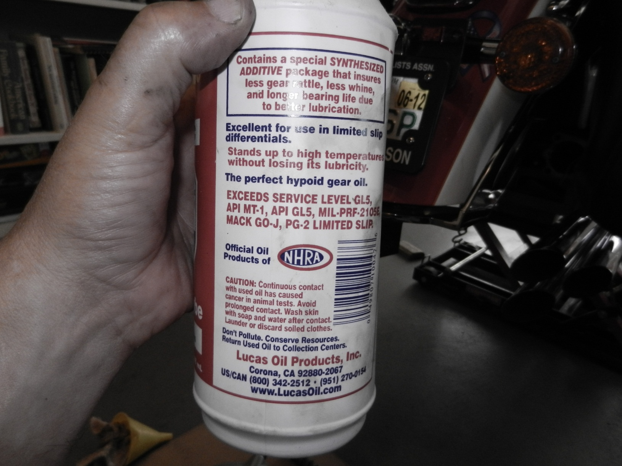
Make sure its Hypoid Rated

Slide 25
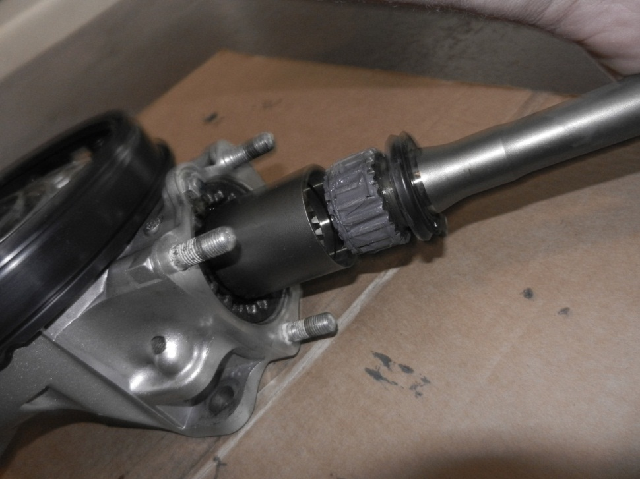
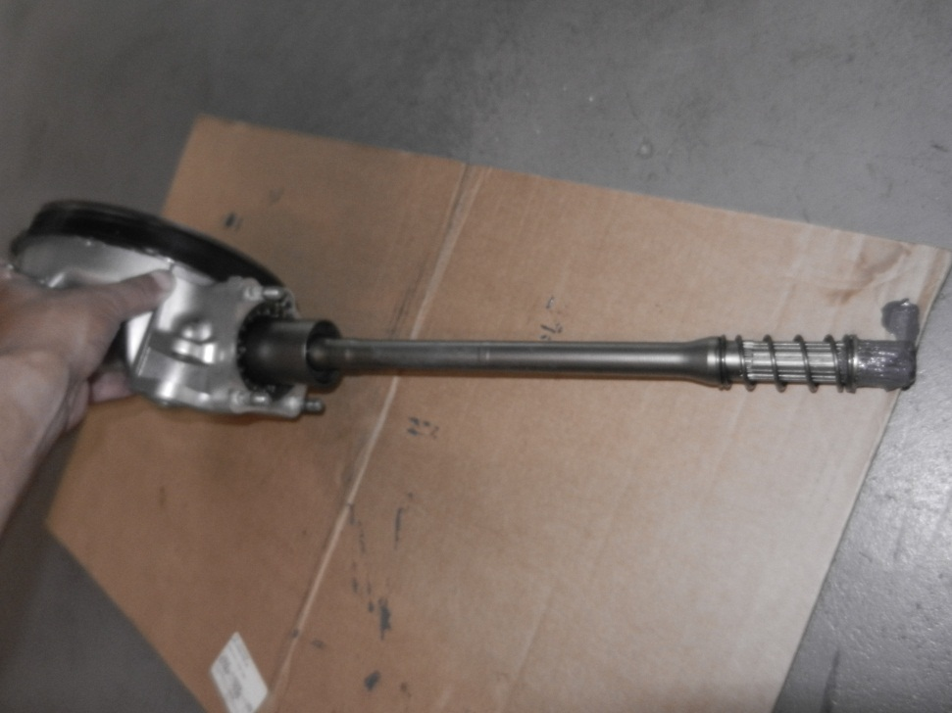
Lightly grease the Drive shaft (both ends) and put it back into the pinion cup
Snaps right in

Slide 26
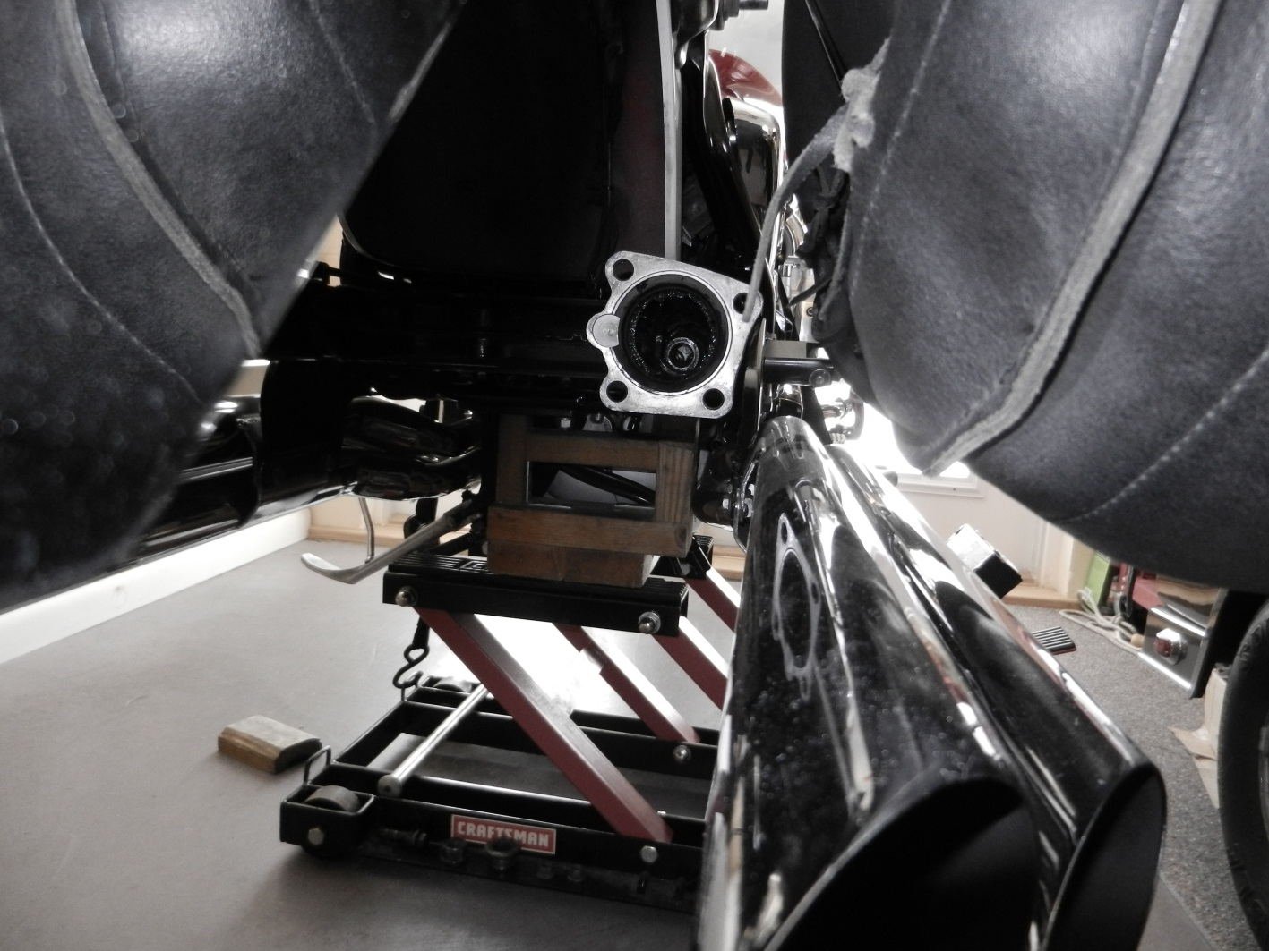
Install the drive train…..Hold the final drive and just find the U-Joint with the driveshaft and its done

Slide 27
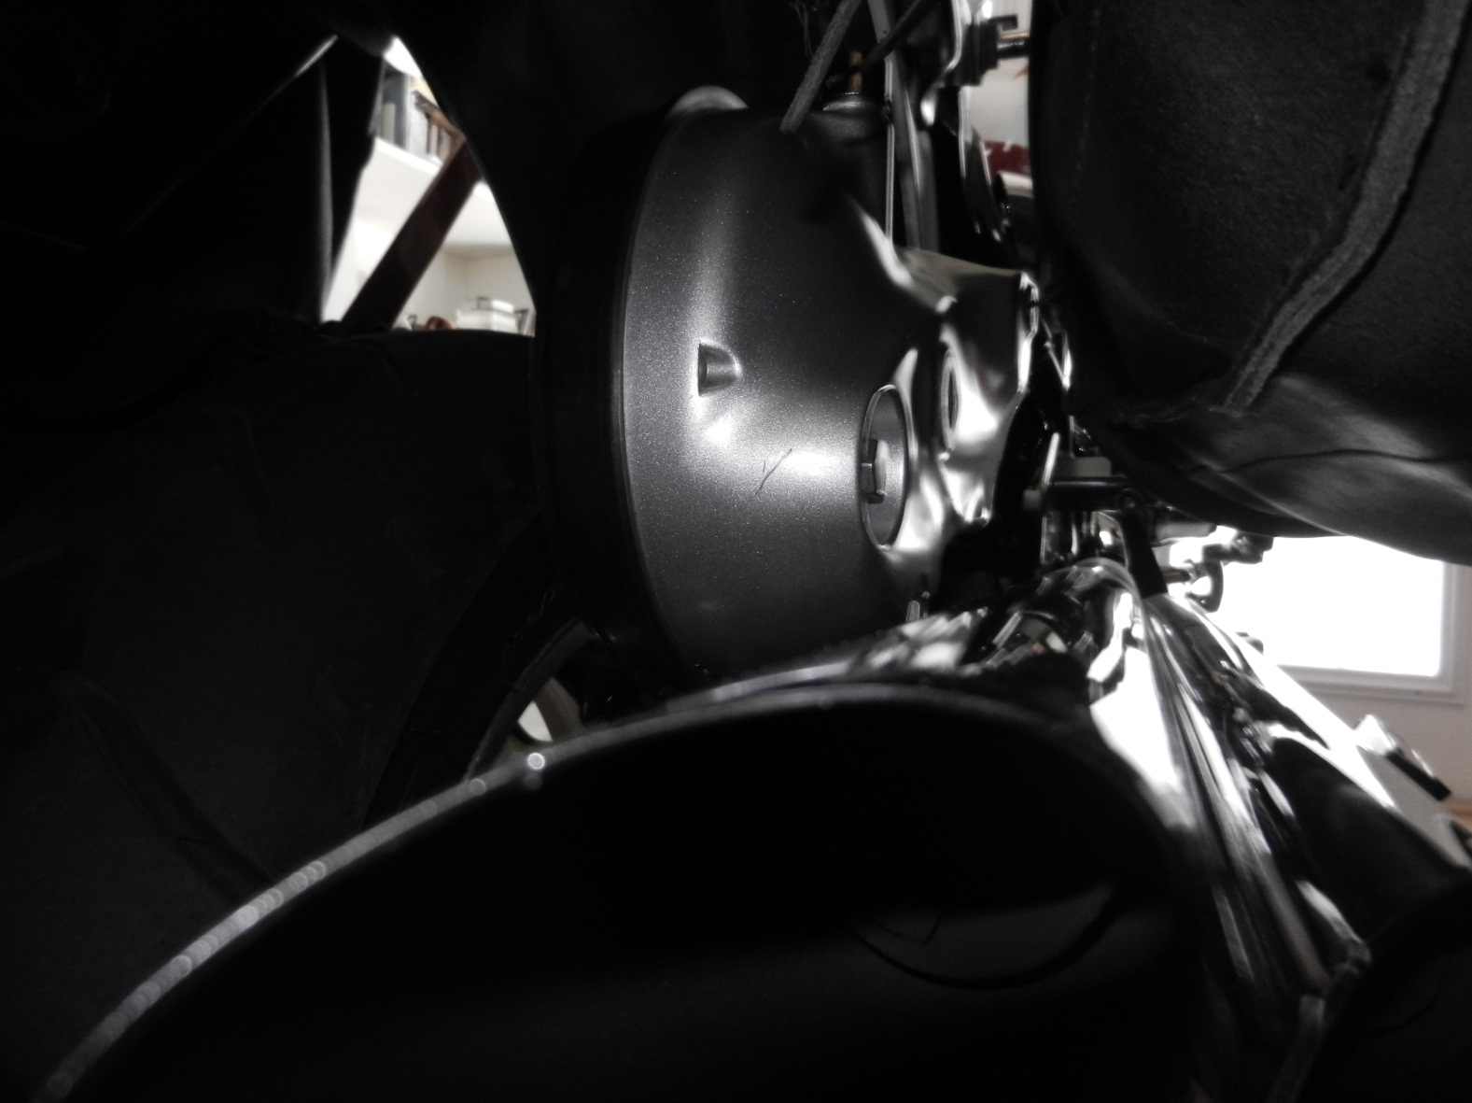
Finger Tight Only on the four bolts holding the Final Drive

Slide 28
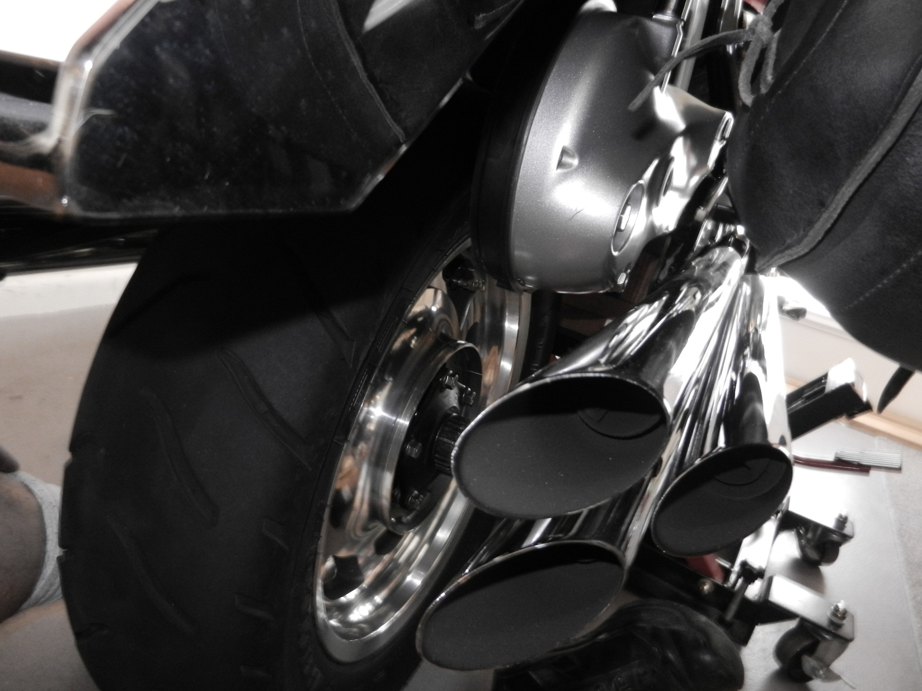
Lift Wheel in place

Slide 29
Now the BIG important three steps after the axle is through the final drive, wheel, spacer, caliper plate and swing arm…
1. Rotate the caliper plate into position and install the pin (bolt) that plate sure isin’t going to move after you torque the axle.
2. Torque the axle to 81ftlbs while the final drive is loose and free and the 4 bolts are only finger tight
3. Torque the 4 Final Drive Bolts to 47ftlbs and now you have a properly aligned rear end.

Slide 30
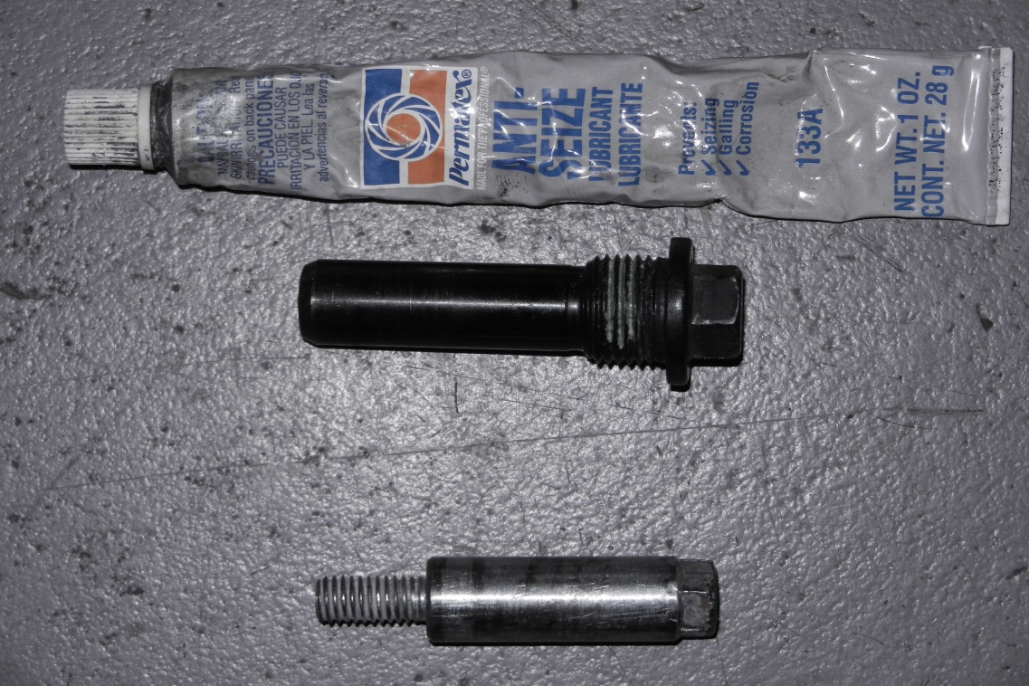
Installing the right side lower shock bolt and the caliper plate holding pin
These are both “pins” they just go through a hole to block movement. They will not hold any better if you over tighten them. Use anti seize on the threads of both of them (especially the shock bolt because its steel into aluminum) and snug them up about as tight as a spark plug
Caliper plate holding bolt (pin)
Right side lower shock bolt

Slide 31
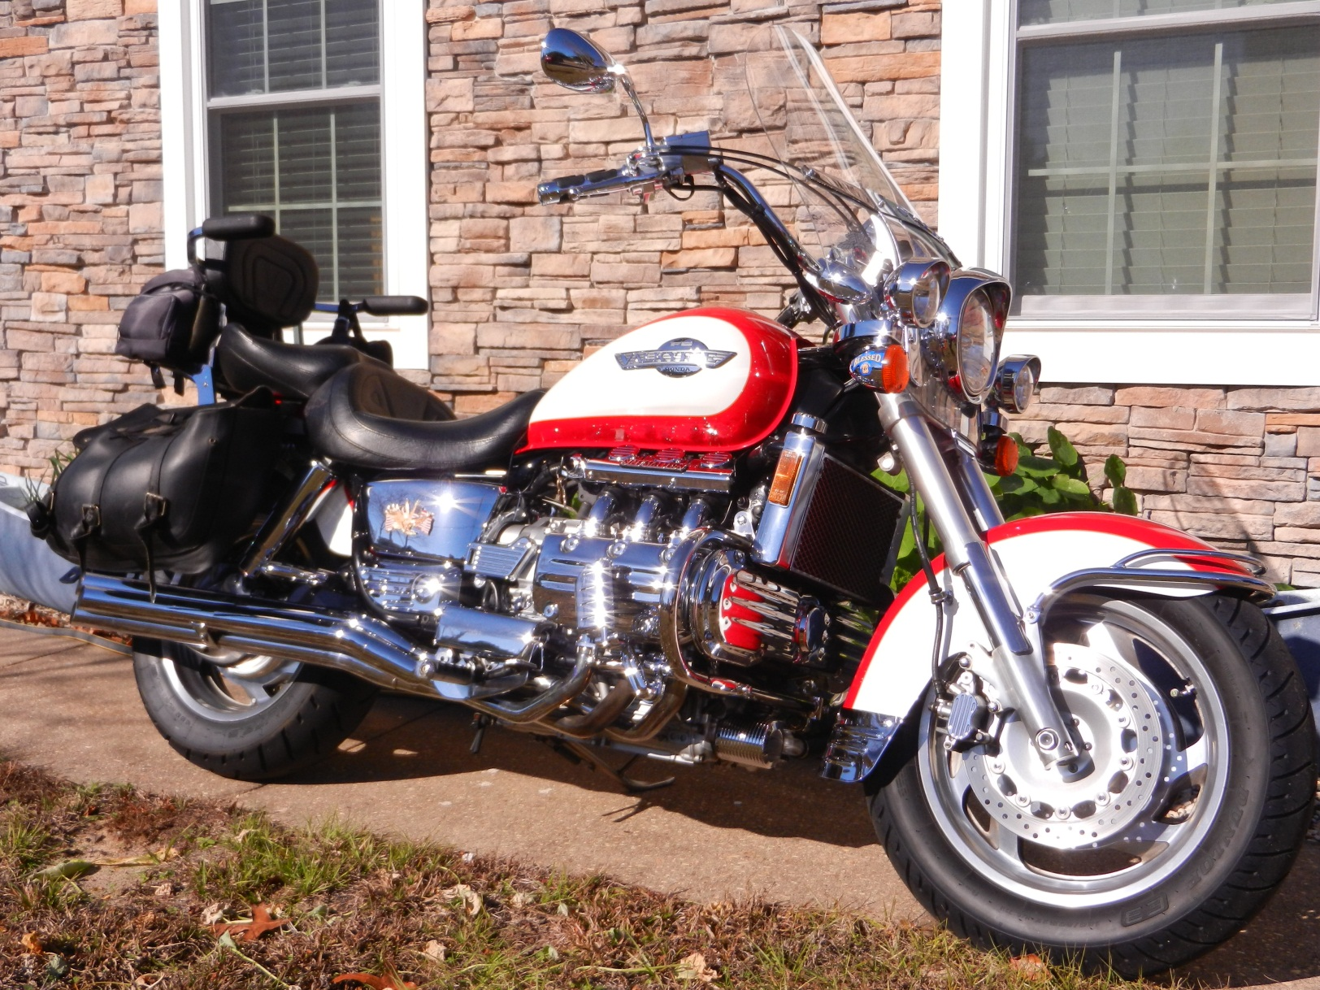
Put the Shocks back on and you are ready to ride

